Slide 1
Software Construction & Development
Week 08
Abeeha Sattar

Slide 2
Design Patterns

Slide 3
What is a Design Pattern?
Design patterns are typical solutions to commonly occurring problems in software design. They are like pre-made blueprints that you can customize to solve a recurring design problem in your code.

Slide 4
Design Patterns v/s Algorithms
Patterns are often confused with algorithms, because both concepts describe typical solutions to some known problems
An algorithm always defines a clear set of actions that can achieve some goal
A pattern is a more high-level description of a solution.
The code of the same pattern applied to two different programs may be different.

Slide 5
What does the pattern consist of?
Intent of the pattern briefly describes both the problem and the solution.
Motivation further explains the problem and the solution the pattern makes possible.
Structure of classes shows each part of the pattern and how they are related.
Code example in one of the popular programming languages makes it easier to grasp the idea behind the pattern.

Slide 6
Singleton Pattern
Intent:
Singleton is a creational design pattern that lets you ensure that a class has only one instance, while providing a global access point to this instance.

Slide 7
Singleton Pattern
Problem:
The Singleton pattern solves two problems at the same time. (thus it violates the single responsibility principle)
The two problems are:
Ensure that a class has just a single instance
Provide a global access point to that instance
How is it different from a global variable?

Slide 8
Singleton Pattern
Solution:
All implementations of the Singleton have these two steps in common:
Make the default constructor private, to prevent other objects from using the new operator with the Singleton class.
Create a static creation method that acts as a constructor. Under the hood, this method calls the private constructor to create an object and saves it in a static field. All following calls to this method return the cached object.

Slide 9
Real-World Analogy
The government is an excellent example of the Singleton pattern. A country can have only one official government. Regardless of the personal identities of the individuals who form governments, the title, “The Government of X”, is a global point of access that identifies the group of people in charge.

Slide 10
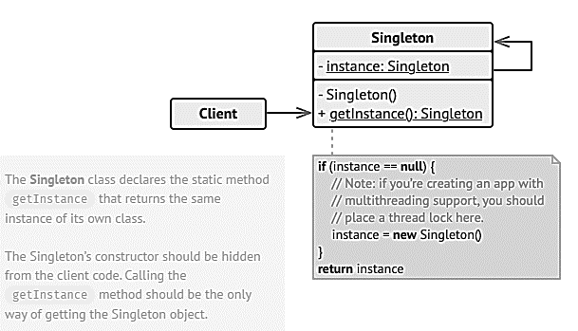
Structure

Slide 11
Code

Slide 12
Applicability
Use the Singleton pattern when a class in your program should have just a single instance available to all clients; for example, a single database object shared by different parts of the program.
The Singleton pattern disables all other means of creating objects of a class except for the special creation method. This method either creates a new object or returns an existing one if it has already been created.
Use the Singleton pattern when you need stricter control over global variables.
Unlike global variables, the Singleton pattern guarantees that there’s just one instance of a class. Nothing, except for the Singleton class itself, can replace the cached instance.

Slide 13
Observer Pattern
Intent:
Observer is a behavioral design pattern that lets you define a subscription mechanism to notify multiple objects about any events that happen to the object they’re observing.

Slide 14
Observer Pattern
Problem:
Imagine that you have two types of objects:
Customer
Store
The customer is very interested in a particular brand of product (say, it’s a new model of the iPhone) which should become available in the store very soon.
Notes:
The customer could visit the store every day and check product availability. But while the product is still en route, most of these trips would be pointless.
On the other hand, the store could send tons of emails (which might be considered spam) to all customers each time a new product becomes available. This would save some customers from endless trips to the store. At the same time, it’d upset other customers who aren’t interested in new products.
It looks like we’ve got a conflict. Either the customer wastes time checking product availability or the store wastes resources notifying the wrong customers.

Slide 15
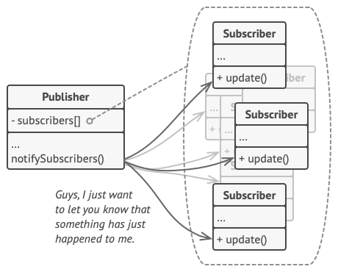
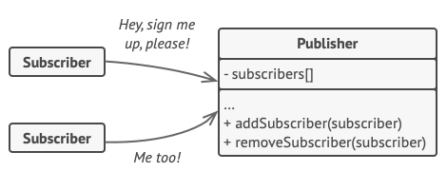
Observer Pattern
Solution:
The Observer pattern suggests that you add a subscription mechanism to the publisher class so individual objects can subscribe to or unsubscribe from a stream of events coming from that publisher.
Notes:
The customer could visit the store every day and check product availability. But while the product is still en route, most of these trips would be pointless.
On the other hand, the store could send tons of emails (which might be considered spam) to all customers each time a new product becomes available. This would save some customers from endless trips to the store. At the same time, it’d upset other customers who aren’t interested in new products.
It looks like we’ve got a conflict. Either the customer wastes time checking product availability or the store wastes resources notifying the wrong customers.
The object that has some interesting state is often called subject, but since it’s also going to notify other objects about the changes to its state, we’ll call it publisher.
All other objects that want to track changes to the publisher’s state are called subscribers.

Slide 16
Real-World Analogy
If you subscribe to a newspaper or magazine, you no longer need to go to the store to check if the next issue is available. Instead, the publisher sends new issues directly to your mailbox right after publication or even in advance.
The publisher maintains a list of subscribers and knows which magazines they’re interested in. Subscribers can leave the list at any time when they wish to stop the publisher sending new magazine issues to them.

Slide 17
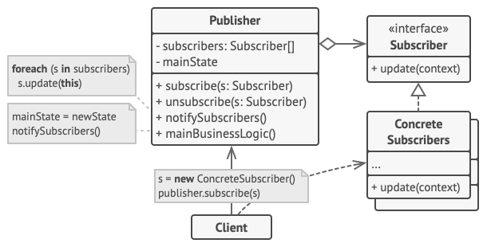
Structure

Slide 18
Code

Slide 19
Applicability
Use the Observer pattern when changes to the state of one object may require changing other objects, and the actual set of objects is unknown beforehand or changes dynamically.
Use the pattern when some objects in your app must observe others, but only for a limited time or in specific cases.
The subscription list is dynamic, so subscribers can join or leave the list whenever they need to.

Slide 20
How to Implement?
Look over your business logic and try to break it down into two parts: the core functionality, independent from other code, will act as the publisher; the rest will turn into a set of subscriber classes.
Declare the subscriber interface. At a bare minimum, it should declare a single update method.
Declare the publisher interface and describe a pair of methods for adding a subscriber object to and removing it from the list.
Decide where to put the actual subscription list and the implementation of subscription methods.

Slide 21
How to Implement?
Create concrete publisher classes. Each time something important happens inside a publisher, it must notify all its subscribers.
Implement the update notification methods in concrete subscriber classes.
The client must create all necessary subscribers and register them with proper publishers.

Slide 22
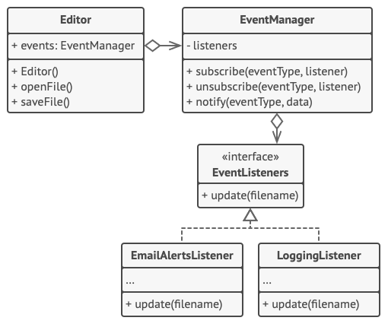
Example

Slide 23
Fin.

